Slide 1





Weather in Gdynia
Top Vis Competition
ARTS 1422
王芸飞 2021533135
Notes:
Today, I am thrilled to present a facinating data visualization that not only intrigues me with its aesthetic appeal but also elegantly/ˈelɪɡəntli/ and intuitivelly communicates complex weather data from the city of Gdynia, that is Weather in Gdynia /ɡəˈdɪnɪə/.

Slide 2

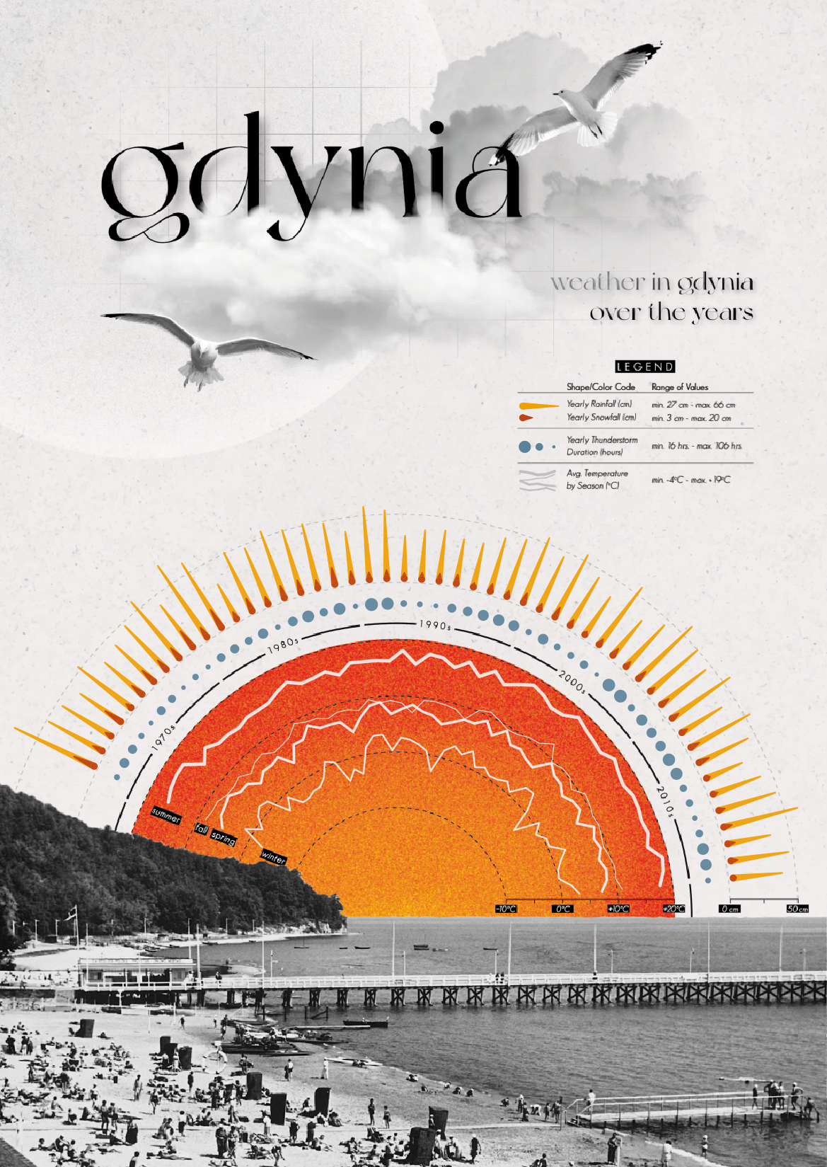

BackGround
Where do I find ?
Tableau Public
Tableau Public is a free platform where you can explore, create, and publicly share data visualizations. Explore the infinite possibilities of data and draw inspiration from it.
Notes:
Let me start with the background of this visualization, which I found on a visualization site called Tableau Public.
Tableau Public is a free platform where you can explore, create, and publicly share data visualizations. Explore the infinite possibilities of data and draw inspiration from it.
The author created this visualization out of his love for the city of Gdynia in order to show the various weather conditions in the city.
what message can it coney?
This cursory /ˈkɜːrsəri/examination reveals not just yearly temperature cycles but also potential anomalies or shifts in weather patterns over the years.

Slide 3
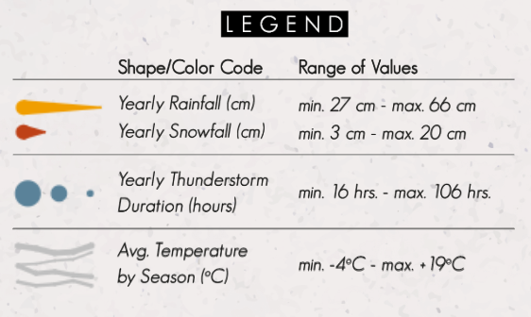

Encoding Scheme
Notes:
Then comes the encoding scheme part.
first of all, the visualization as a whole looks like a sunrise. Inside the center semicircle, the average temperature change of four seasons is shown by line. And the encoding of temperature is done in color, from orange to red, the temperature increases gradually.
Next out is an encoding of the annual thunderstorm duration in point size, the larger the point, the longer the duration.
Further out is the encoding of the yearly rainfall and snowfall in beam length, and the color used to distinguish between the two. The longer the beam, the larger the corresponding amount. Also we have a timeline as the another axis.

Slide 4

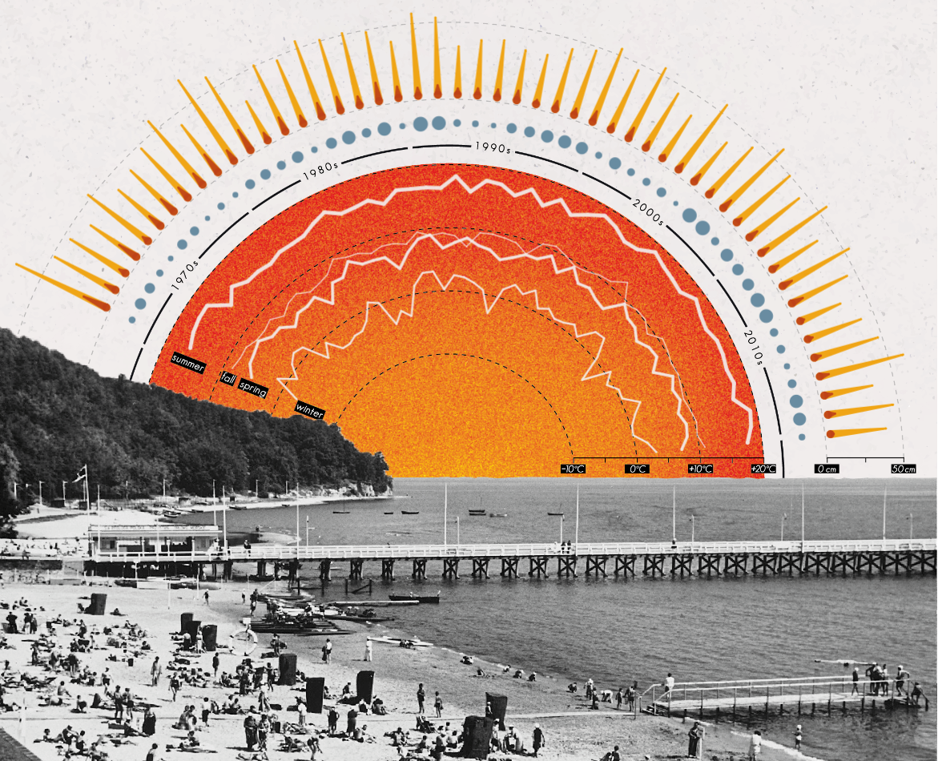

How I Feel
1. Aesthetics
· Main part: A semi sun
· External part: Many trailing beams of light
2. Intuitiveness
· Line position
· Point size
· Beam length
3. Effectiveness
· Easy to read
· Yearly continuous
· No redundancy or tedious content
Notes:
The next part is how I feel and why the visualization is impressive
1. First, Different types of weather data are naturally /ˈnætʃ(ə)rəli/encoded as half a sun and its outwardly radiating beams of light. The use of sun motifs infuses a sense of warmth and vitality into what could otherwise be mundane numerical/nuːˈmerɪk(ə)l/ data. It transforms statistical information into an artful display, making it visually appealing and engaging.
2. Second, Its design intuitively guides the viewer through the data without the need for extensive explanation. The gradually lengthening beam represents the concept of fall. And the encoding form allows people to easily understand the changes in the weather and grasp the patterns.
3. Third, By condensing years of weather data into a single, coherent image, this visualization achieves remarkable efficiency in communication. It highlights long-term trends and seasonal patterns with precision /prɪˈsɪʒ(ə)n/, enabling quick insights into Gdynia's climate dynamics.

Slide 5
How I Feel
4. Novelty
· Combine nature and data
· Symbolize
Notes:
4. Fourth, Departing from conventional line graphs or bar charts, this approach innovatively/ˈɪnəveɪtɪv/ employs symbolic representation. Its novelty lies in its ability to fuse data with art, offering a fresh perspective on data visualization.
In conclusion, this visualization of Gdynia's weather patterns captivates through its harmonious blend of aesthetics and functionality.
mainly represents the concept of combination of data and nature.
It exemplifies how data, when creatively presented, can tell compelling stories and foster a deeper understanding of our world.

Slide 6




That is all! Thank you!
Notes:
s

